Slide 1

Start-Up Acceleration
MULTI-THREADED SEARCH ENGINE
Presented by
SONU KURUVILA
Electronics And Communication Engineer
Amal Jyothi college of Engineering
INSPIRING EXCELLENCE Copyright 2020 SkillAssure

Slide 2

AGENDA
Project Introduction
Project Features
Key Tech Elements
LLD - Class Design
Key Focus
Project Code Flow
GIT Repository
Code Walkthrough
Q n A

Slide 3
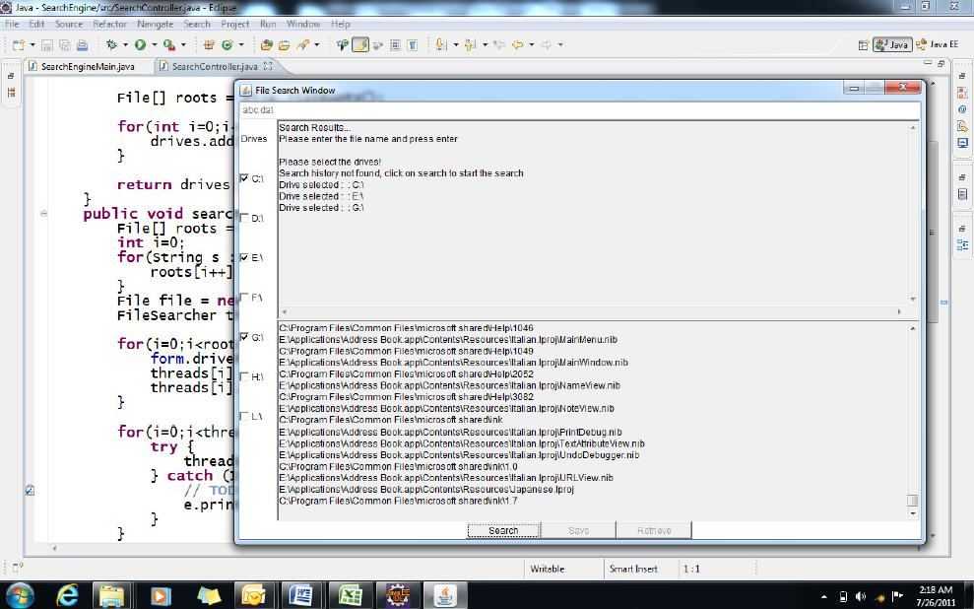
PROJECT INTRODUCTION
Multi-Threaded Search Engine
We need to build a Desktop Search Application like Windows File Search.
This application unlike, the classical Windows Search Application will be multithreaded and hence very fast when compared to the classical search application available in Windows.

Slide 4
PROJECT FEATURES
Requirements:
Detect the ROOTS / DRIVES in the system
Allow the user to select the DRIVES in which the file needs to be searched
Take the file that has to be searched as an input from the user
Perform the search by spawning one thread for each root / drive
Store the search results in a log
When a new search is initiated, check the history (or the log file) for availability of the previous search history
If the search history is available, display the search results after validating the existence of each file in the search history
If the search history is not found, then initiate a new search
Features:
Detect Drives (Active & All Drives)
Accept File to Search
Search for File
Search in History
Display Result from History
Search – Multi-Threading
Display Search Result

Slide 5








TECHNOLOGY ELEMENTS

Slide 6
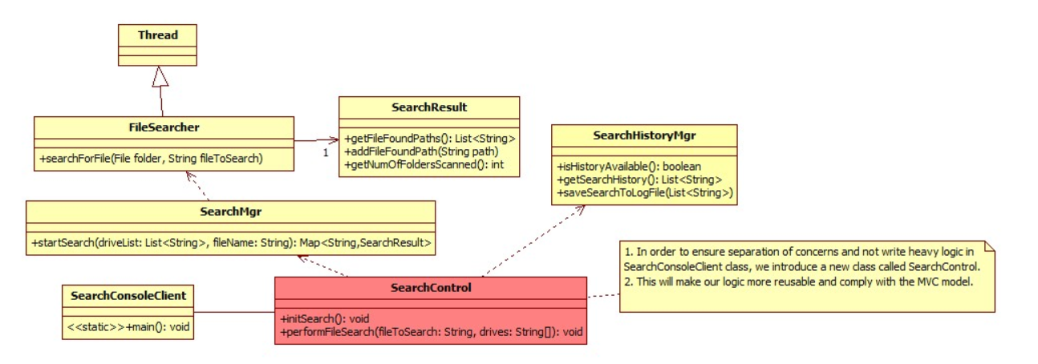
PROJECT CODE WORKFLOW

Slide 7
PROJECT CODE WORKFLOW
Client
RootFinderFactory
SearchHistoryManager
SearchManagerFactory
main
create
create
getSearchResults
detectRoots
IRootFinder
ISearchManager
acceptchoice
storeSearch
AllRoot
ActiveRoot
Searchmanager
displayDrives
acceptFileToSearch
getDrives
getDrives
search
search
displayPath
getDrives
FileSearcher
Runnable
getPathsFound
search
run

Slide 8
PROJECT CODE WORKFLOW
Client
detectRoots
displayDrives
acceptFileToSearch
SearchHistoryManager
getSearchResults
Variable results
If null
true
ISearchManager
false
displayPath

Slide 9
KEY FOCUS
Packages
OO Concepts
Abstraction
Interfaces
Exception Handling
IO Stream
CLASSES
File Handling
Multi Threading
Java Util Collection
Collections

Slide 10
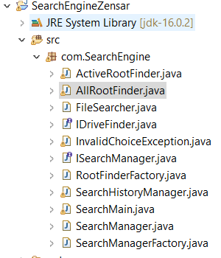
FOLDER STRUCTURE

Slide 11
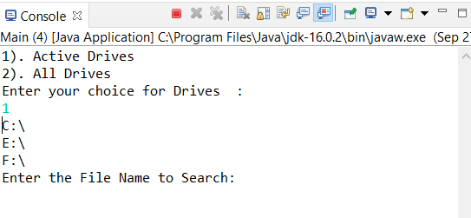
SNAPSHOTS

Slide 12
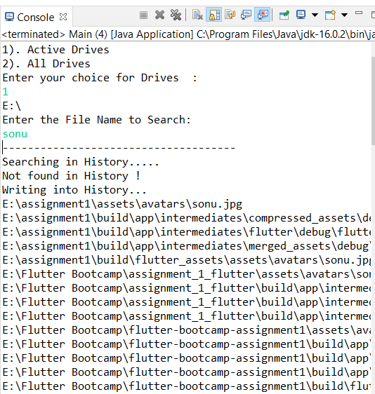
SNAPSHOTS

Slide 13
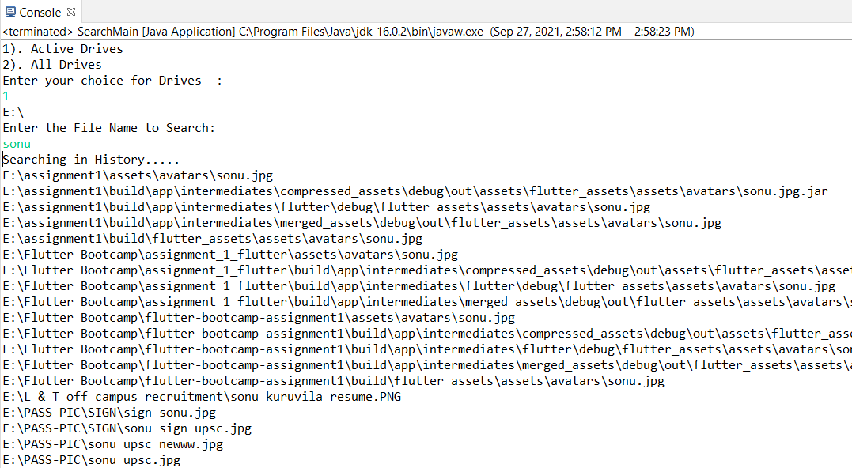
SNAPSHOTS

Slide 14
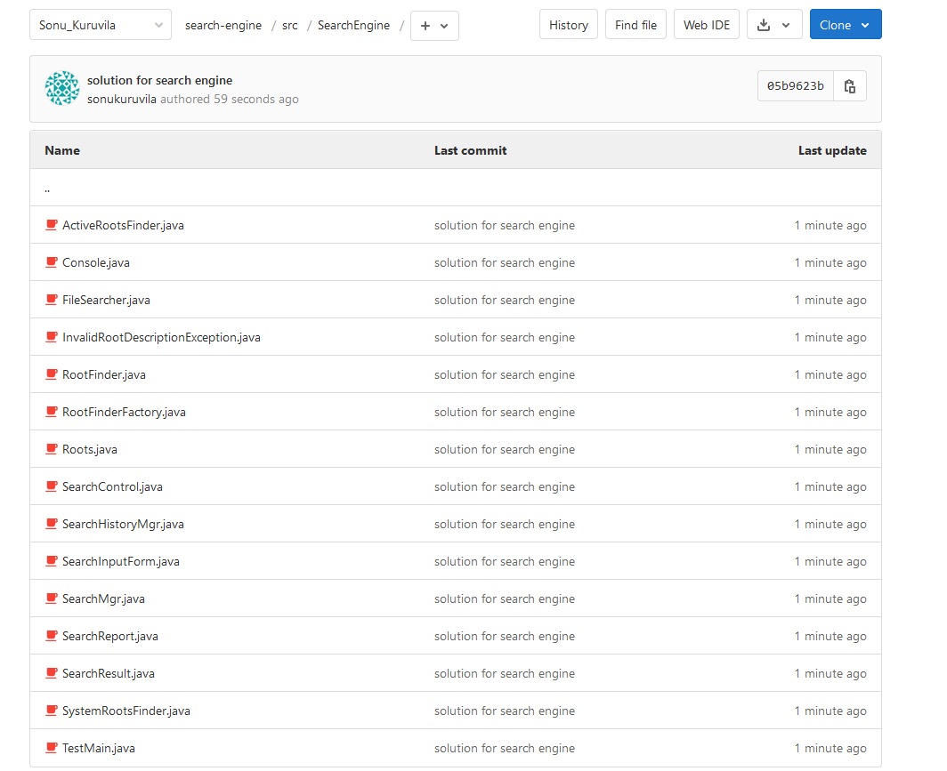
GIT REPOSITORY
Git Repository

Slide 15
DEMO

Slide 16
Q n A

Slide 17

Thank You
© Pratian Technologies (India) Pvt. Ltd, 2020

